Slide 1

Futurense Technologies Group #2
Entity Relationship (ER) Diagrams
By-
1. Abhinav Kumar
2. Manish Ghosal
3.Omkar Prasad
4.Rohit L
5.Akshay R
6.Bhavya Karia

Slide 2
Agenda
Introduction to ER Diagrams
Shapes and their description
Problem statement 1
Problem statement 2
Problem statement 3
Conclusion

Slide 3

Introduction to ER-Diagrams
An ER (Entity-Relationship) diagram is a visual representation of the entities, attributes, and relationships within a database system. It is a modelling technique used to design databases and describe the logical structure of data.
Entity
Things in the real world (Employee)
Attribute
• Property of an entity • Most of what we store in the database (Name, Age, Position, Salary)
Relationship
Association between sets of entities with possibly with attribute(s) (Employee to Product)

Slide 4
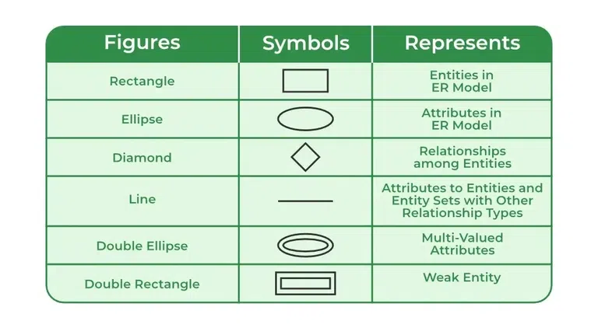
Shapes and their description
Rectangles: Rectangles represent Entities in the ER Model.
Ellipses: Ellipses represent Attributes in the ER Model.
Diamond: Diamonds represent Relationships among Entities.
Lines: Lines represent attributes to entities and entity sets with other relationship types.
Double Ellipse: Double Ellipses represent Multi-Valued Attributes.
Double Rectangle: Double Rectangle represents a Weak Entity.

Slide 5
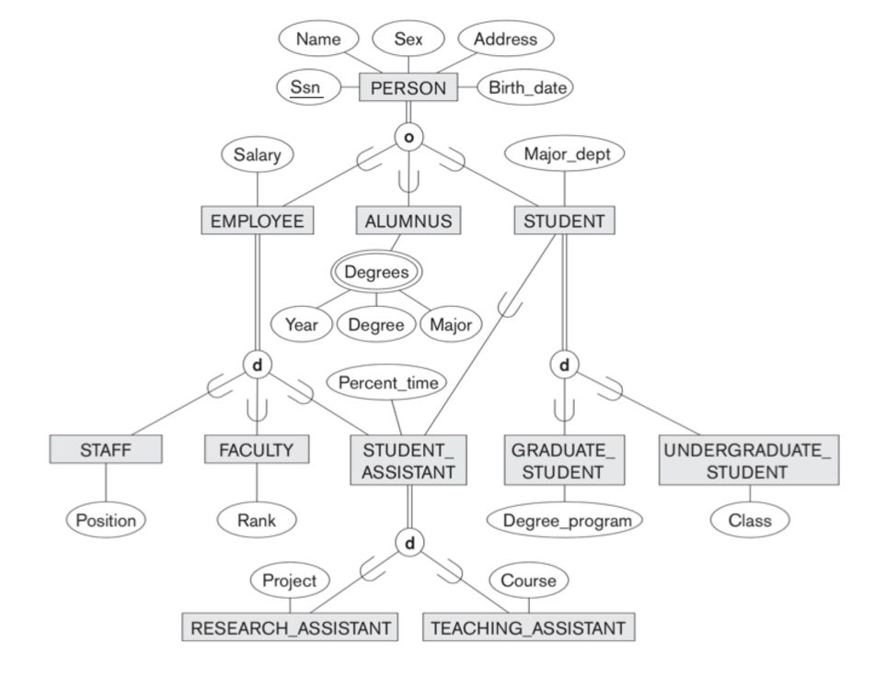
Problem statement 1
The database keeps track of three types of persons: employees, alumni, and students. A person can belong to one, two, or all three of these types. Each person has a name, SSN, sex, address, and birth date.
Every employee has a salary, and there are three types of employees: faculty, staff, and student assistants. Each employee belongs to exactly one of these types. For each alumnus, a record of the degree or degrees that he or she earned at the university is kept, including the name of the degree, the year granted, and the major department. Each student has a major department.

Slide 6
Problem statement 2
Each faculty has a rank, whereas each staff member has a staff position. Student assistants are classified further as either research assistants or teaching assistants, and the percent of time that they work is recorded in the database. Research assistants have their research project stored, whereas teaching assistants have the current course they work on.

Slide 7
Problem statement 3
Students are further classified as either graduate or undergraduate, with the specific attributes of degree program (M.S., Ph.D., M.B.A., and so on) for graduate students and class (freshman, sophomore, and so on) for under-graduates.

Slide 9

Conclusion
Flexibility: The database can easily handle information for people with different roles (like students, employees, alumni) even if they fit into more than one category.
Depth of Information: The database collects a lot of detailed information, helping the school make smart decisions based on comprehensive data.
Management: The database organizes information in a clear way, making it easier for the school to manage resources and oversee operations effectively.

